Slide 1

Graph Theory and Its Applications
Centrality Analysis
Dr. Arti Arya
Department of Computer Science
and Engineering

Slide 2

Graph Theory and Its Applications
Degree Centrality
Arti Arya
Department of Computer Science and Engineering

Slide 3

Graph Theory and its Applications Acknowledgement
The slides are prepared from various resources of Foreign and Indian Universities and from reliable resources from the internet. The contribution is also from various Professors of the University.

Slide 4
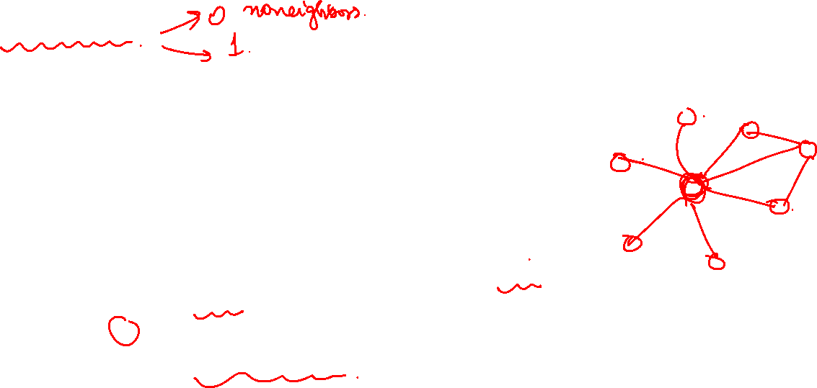
Graph Theory and its Applications UE21CS343AB3
Closeness centrality
The intuition is that influential and central nodes can quickly reach other nodes.
It shows how close the node is to the rest of the graph.
This centrality (normalized) is also ranges from 0 (the node has no neighbours; it is severed from the rest of the network) to 1 (the node is the hub of the global star and is one hop away from any other node).

Slide 5
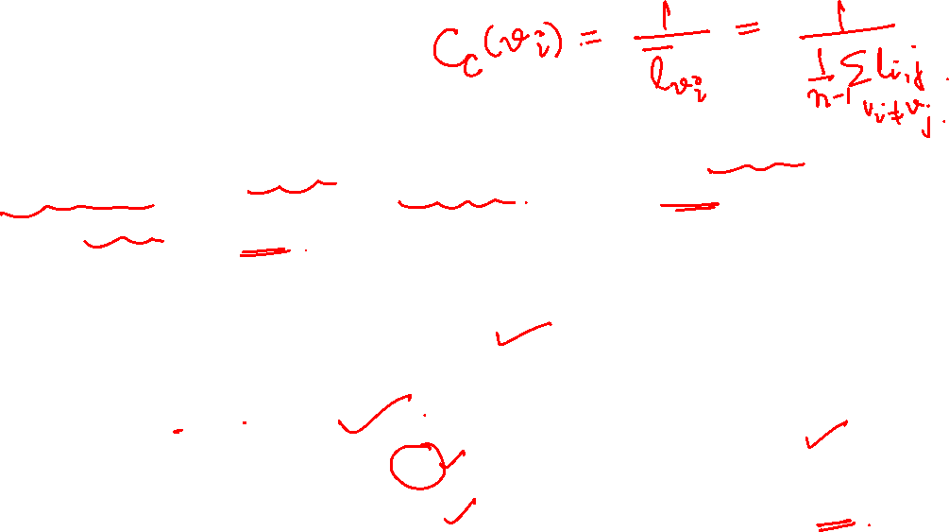
NETWORK ANALYSIS AND MINING
Closeness centrality
Most central nodes should have a smaller average shortest path length to other nodes i.e. defined as the reciprocal mean distance (length of the geodesics) from a node to all other reachable nodes in the network.
The smaller the average shortest path length (geodesic) i.e. distance, the higher the centrality i.e. closeness for the node.
Closeness centrality: where

Slide 6
Graph Theory and its Applications UE21CS343AB3
For Your Information
A geodesic is the shortest path between two points on a surface. In mathematics and geometry, it is often used to describe the shortest distance between two points in a space or on a curved surface, such as a sphere or a more complex manifold. Geodesics are a fundamental concept in differential geometry

Slide 7
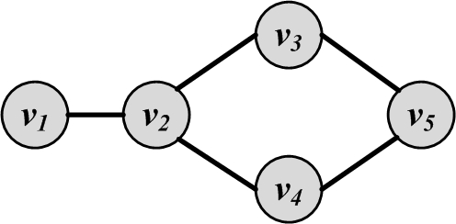
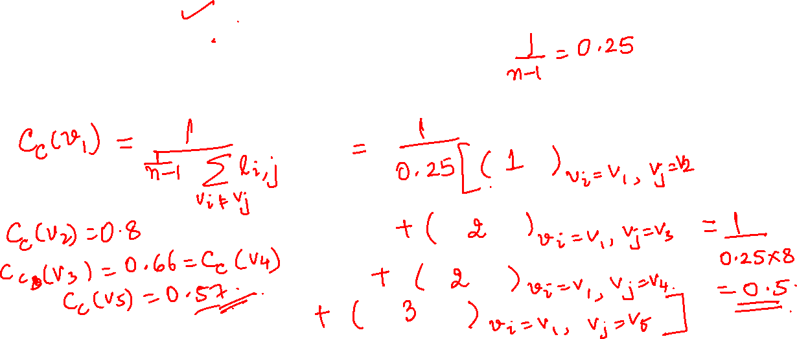
Graph Theory and its Applications UE21CS343AB3
Calculate
Compute the closeness centrality for all the nodes.

Slide 8
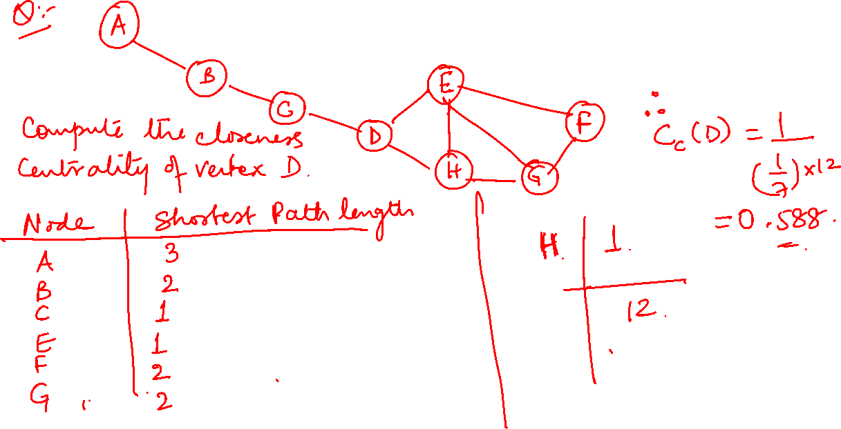
Graph Theory and its Applications UE21CS343AB3

Slide 9
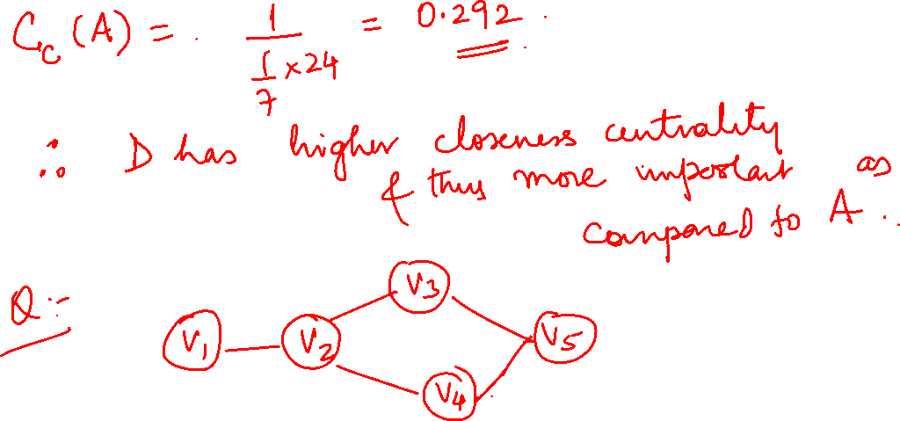
Graph Theory and its Applications UE21CS343AB3

Slide 10
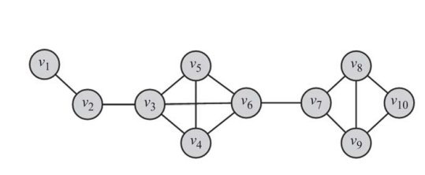

Graph Theory and its Applications UE21CS343AB3
Calculate( Compute yourself)
Compute the top 3 central nodes based on Degree, Betweenness and closeness.
Degree Centrality: (v3, v6, any of the nodes from (v4, v5, v7, v8, v9) or (v6, v3, any of the nodes from (v4, v5, v7, v8, v9)
Bet Centrality: (v6, v3, v4 or v5)
Closeness :(v6, v3 or v7, v7 or v3)

Slide 11
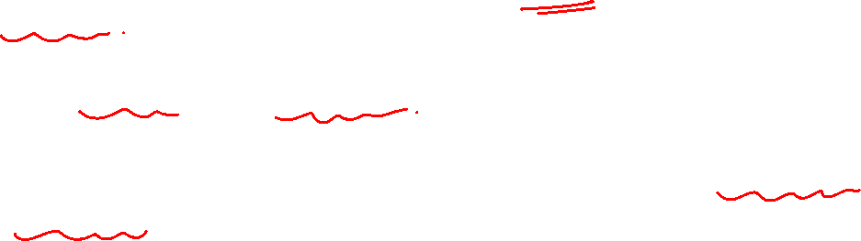
Graph Theory and its Applications UE21CS343AB3
Closeness and harmonic centrality
In closeness centrality, we did reciprocal of the mean distance
Another way to quantify the sense of closeness is to look at the mean reciprocal distance (as opposed to the reciprocal mean distance - the order of the sum and reciprocal operations reverses). Such measure is called harmonic centrality.

Slide 12
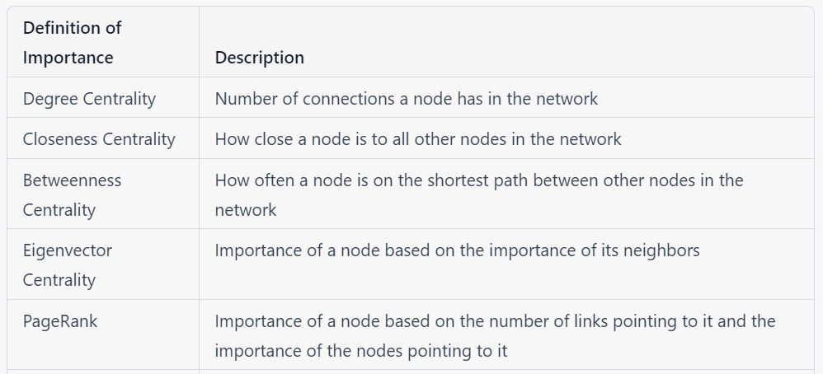
Graph Theory and its Applications UE21CS343AB3
A quick review

Slide 13
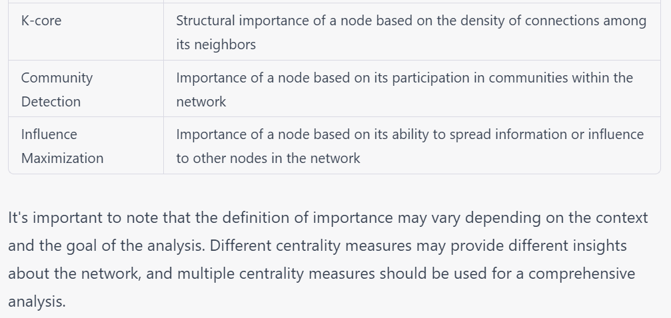
Graph Theory and its Applications UE21CS343AB3
A quick review

Slide 14

Graph Theory and its Applications UE21CS343AB3
Eigenvector centrality
In real-world scenarios, having more friends (degree centrality) does not guarantee that someone is important.
Having more “important” friends provide a stronger signal.
Eigenvector centrality generalizes ‘degree centrality’ by incorporating the importance of the neighbors (or incoming neighbors in directed graphs).
Defined for both directed and undirected graphs.

Slide 15
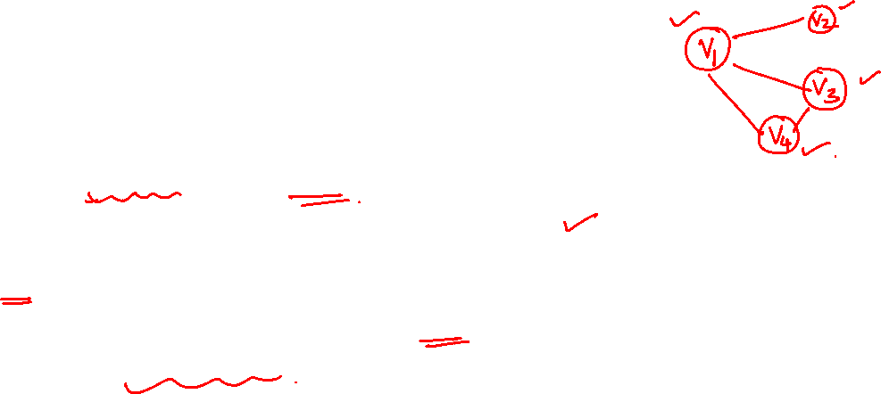
Graph Theory and its Applications UE21CS343AB3
Eigenvector centrality
Each nodes centrality score is dependent on the centrality score of the other nodes in the network.
Eigenvector centrality algorithm will run iteratively across each node in the network (typically initializing all nodes with a centrality score of 1) until each nodes converges upon its eigenvector centrality scores.
At this point, the node with the highest score is deemed to be the most influential node in the network.

Slide 16
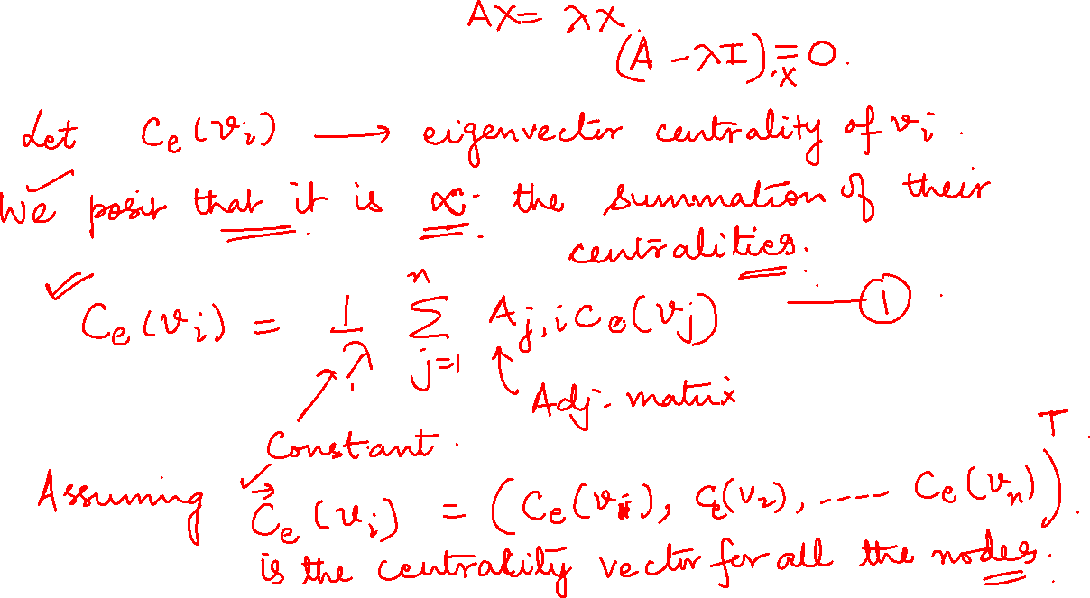
Graph Theory and its Applications
Eigenvector centrality

Slide 17

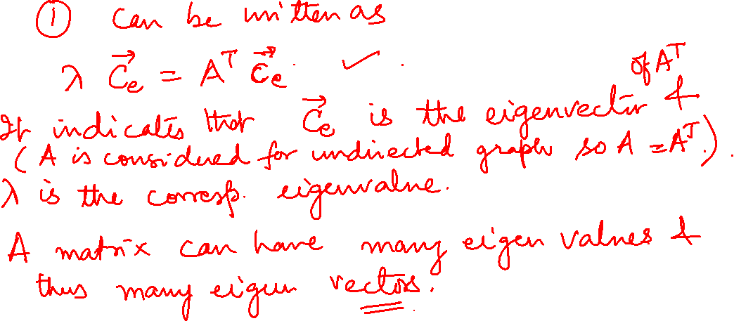
Graph Theory and its Applications UE21CS343AB3
Eigenvector centrality

Slide 18
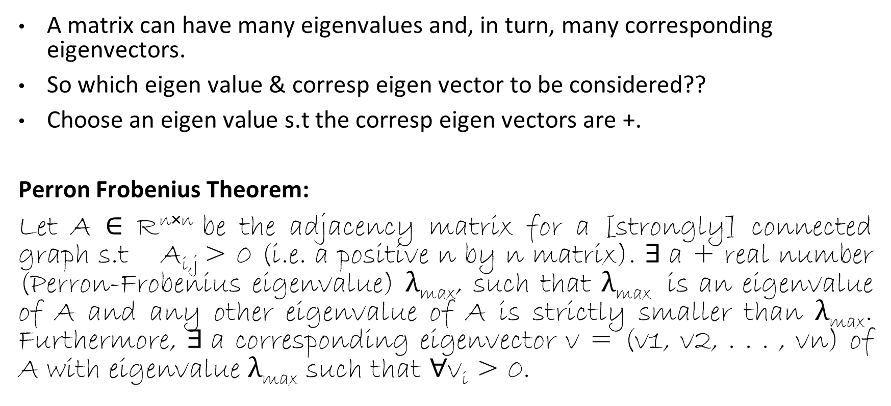
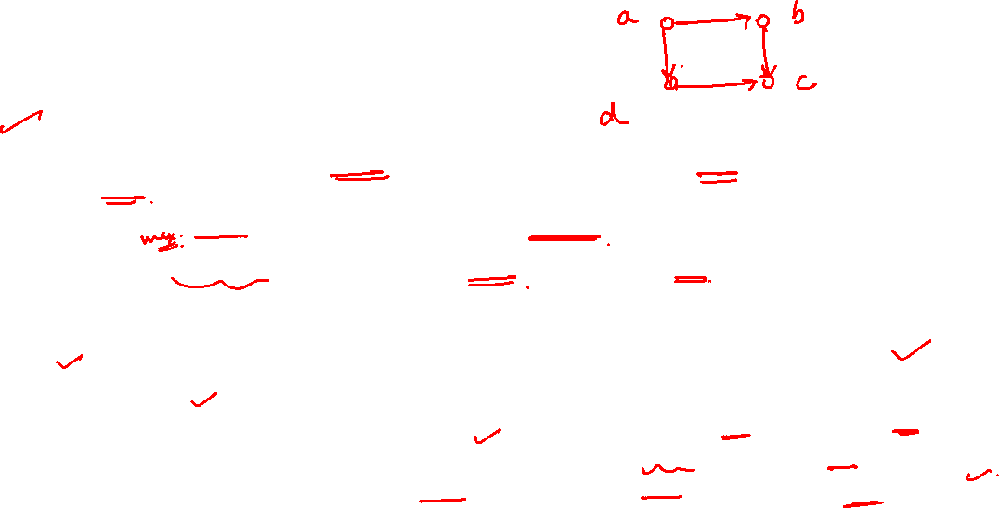
Graph Theory and its Applications UE21CS343AB3
Eigenvector centrality
A matrix can have many eigenvalues and, in turn, many corresponding eigenvectors.
So which eigen value & corresp eigen vector to be considered??
Choose an eigen value s.t the corresp eigen vectors are +.
Perron Frobenius Theorem:
Let A ∈ R^{n×n} be the adjacency matrix for a [strongly] connected graph s.t A_{i,j} > 0 (i.e. a positive n by n matrix). $∃$a + real number (Perron-Frobenius eigenvalue) λ_{max}, such that λ_{max} is an eigenvalue of A and any other eigenvalue of A is strictly smaller than λ_{max}. Furthermore, $∃$a corresponding eigenvector v = (v1, v2, . . . , vn) of A with eigenvalue λ_{max} such that ∀v_{i} > 0.

Slide 19
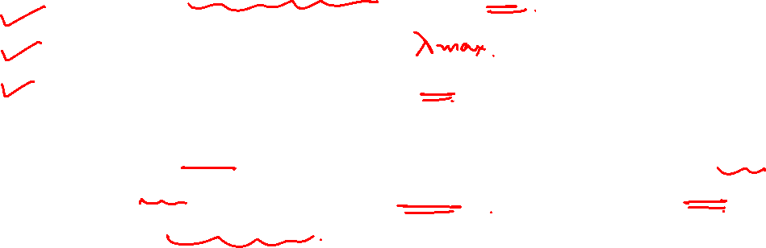
Graph Theory and its Applications UE21CS343AB3
Eigenvector centrality: Example 1
Thus, to have +ve centrality values, we can compute:
Eigenvalues of A
Select the largest eigenvalue
The corresponding eigenvector is C_{e.}
Based of Perron-Frobenius Theorem, all the components of C_{e} will be +ve and this vector corresponds to eigenvector centralities for the graph.

Slide 20
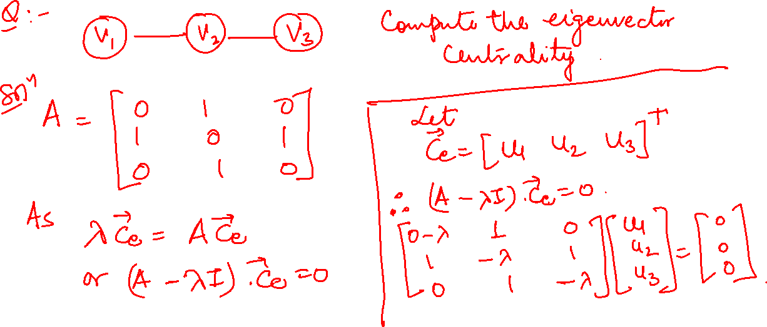
Graph Theory and its Applications UE21CS343AB3
Eigenvector centrality

Slide 21
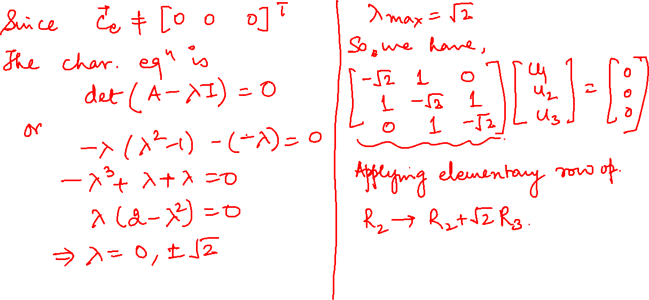
Graph Theory and its Applications UE21CS343AB3
Eigenvector centrality

Slide 22
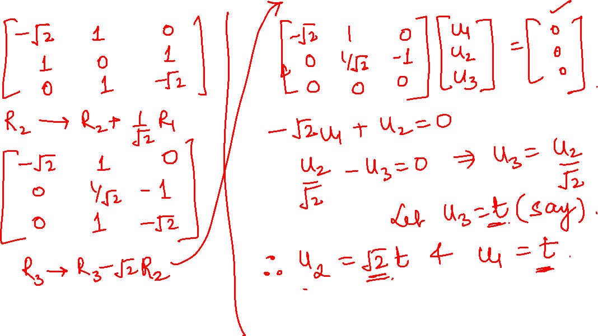
Graph Theory and its Applications UE21CS343AB3
Eigenvector centrality: Example 2

Slide 23
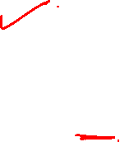
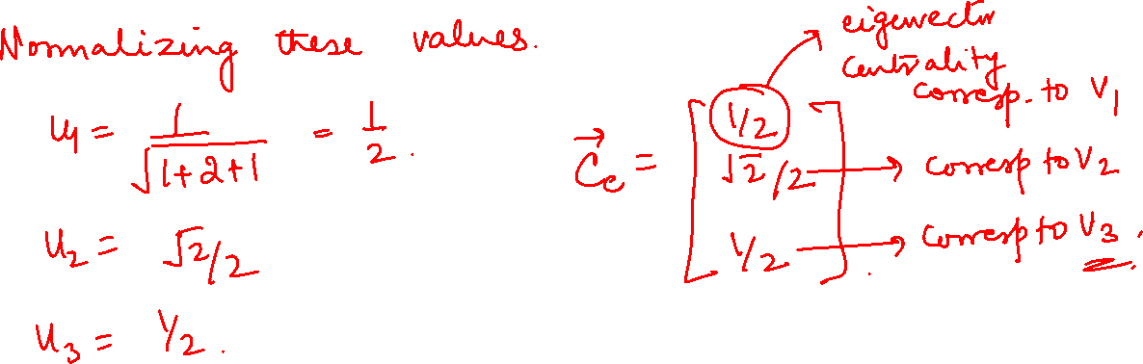
Graph Theory and its Applications UE21CS343AB3
Eigenvector centrality

Slide 24
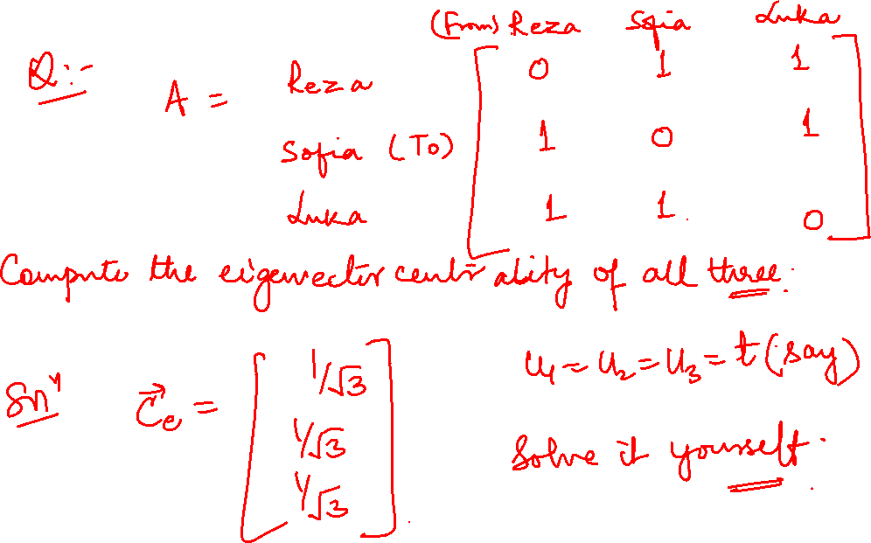

Slide 25
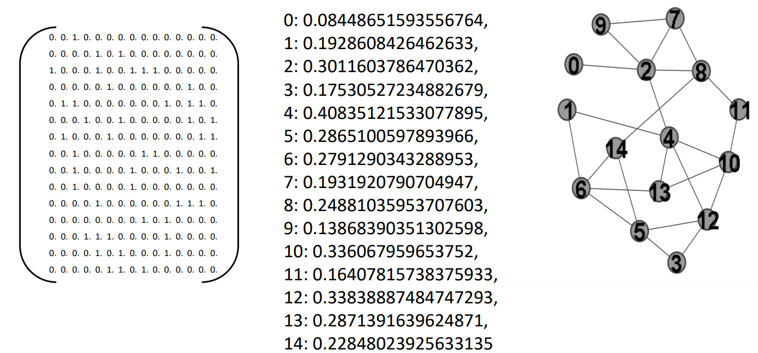
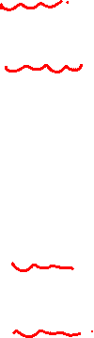
Graph Theory and its Applications UE21CS343AB3
Eigenvector centrality

Slide 26
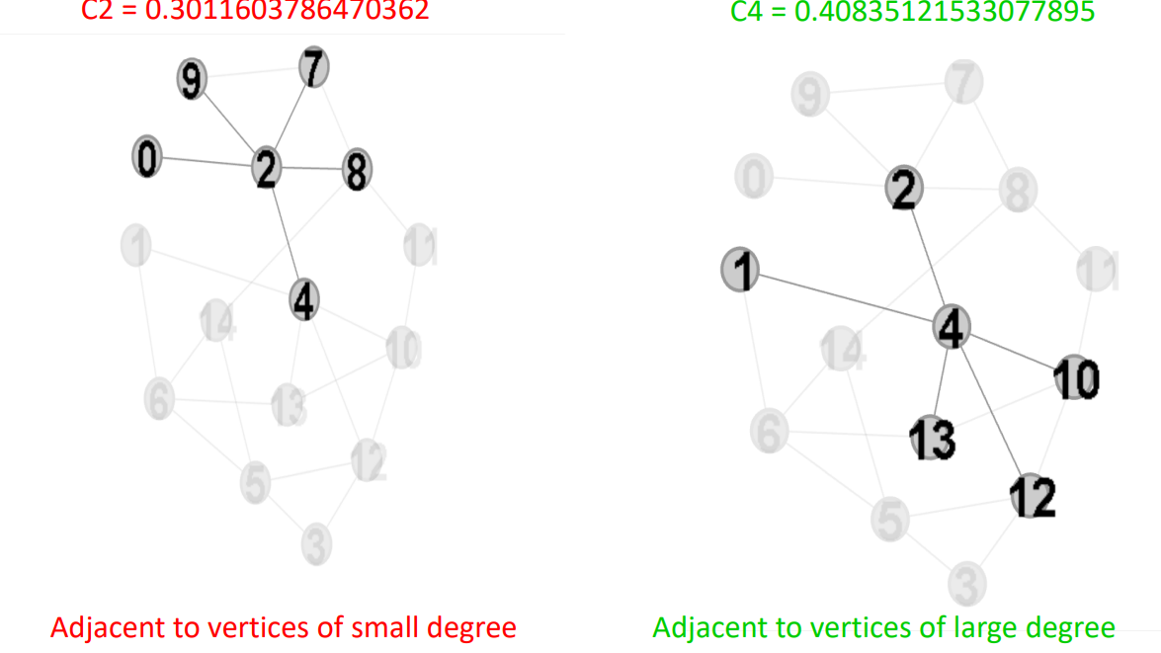


Slide 27
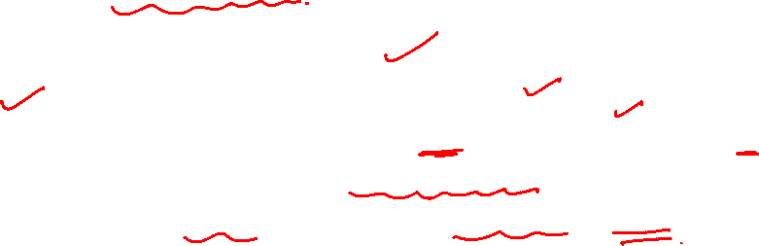
Graph Theory and its Applications UE21CS343AB3
Problem with Eigenvector centrality
A major problem with eigenvector centrality arises when it considers directed graphs.
Centrality is only passed on
when we have (outgoing) edges,
and in special cases like when a node is in a directed acyclic graph, centrality becomes zero, even though the node can have many edges connected to it.
(Any vertex with in-degree zero has centrality value zero and “passes” that value to all vertices to which it points.)

Slide 28
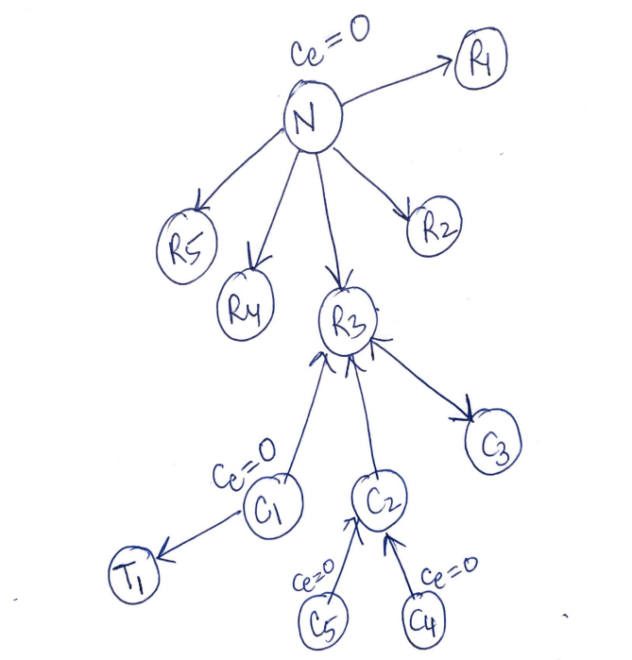

Graph Theory and its Applications UE21CS343AB3
Problem with Eigenvector centrality
It is a problematic measure for directed graphs.
Let’s say that a new research paper N is published and it references a few of existing papers R1, R2, R3, R4, R5.
N would not contribute to any of those referenced papers in this citation network because it is not cited by any other papers and has zero eigenvector centrality.
In other words, eigenvector centrality would not take zero in-degree nodes into account in directed graphs such as citation networks.

Slide 29
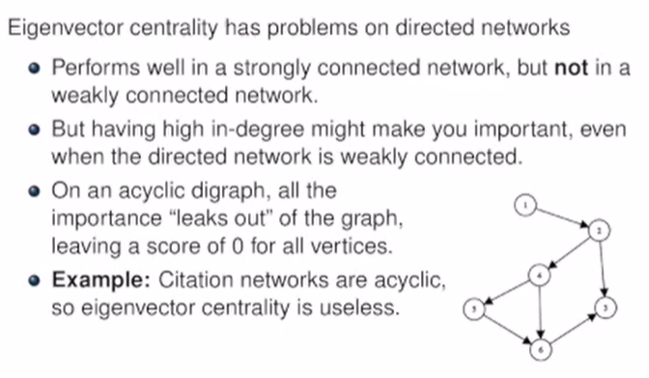

Graph Theory and its Applications UE21CS343AB3
Problem with Eigenvector centrality

Slide 30
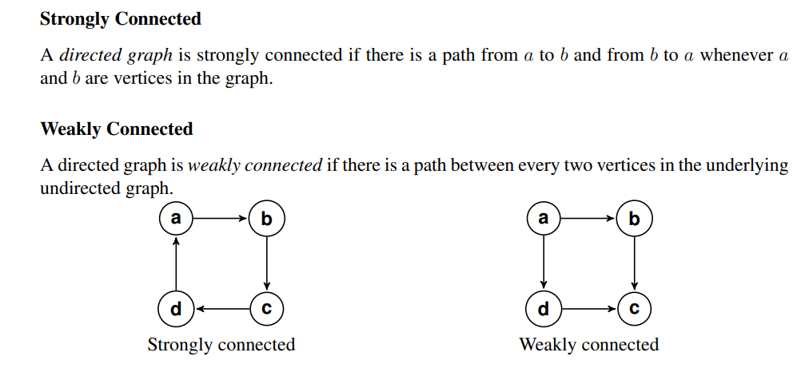
Graph Theory and its Applications UE21CS343AB3
FYI

Slide 31
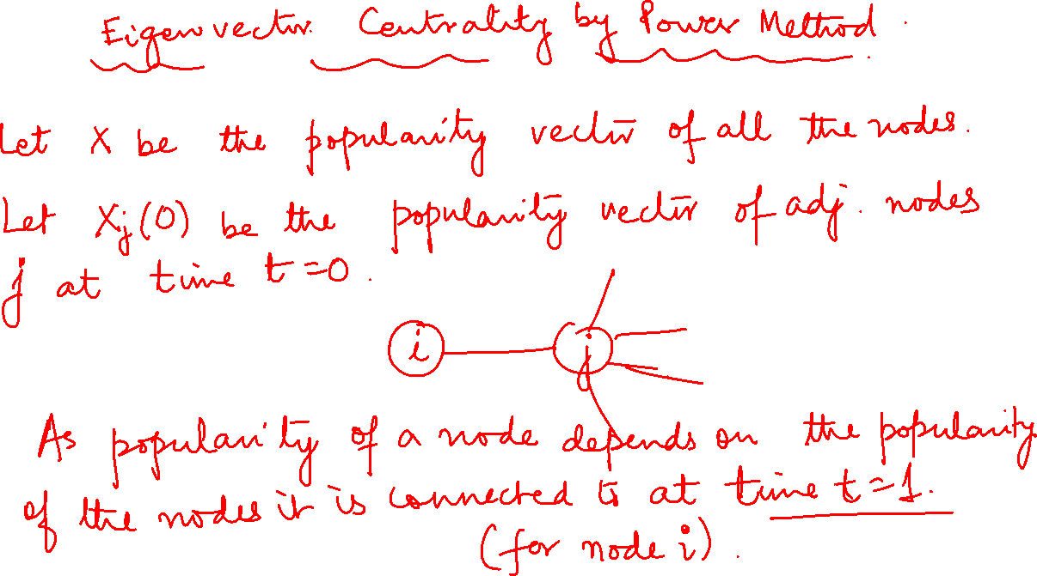


Slide 32
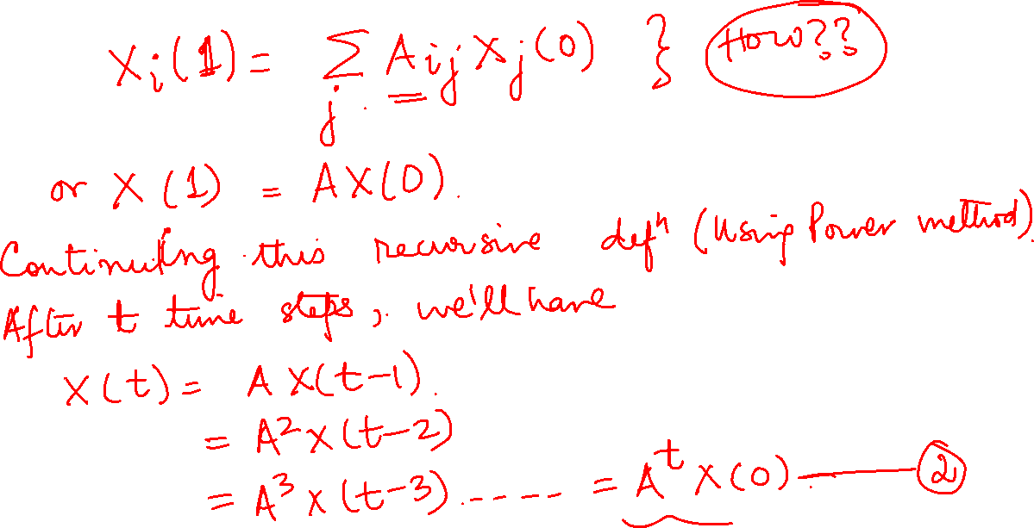
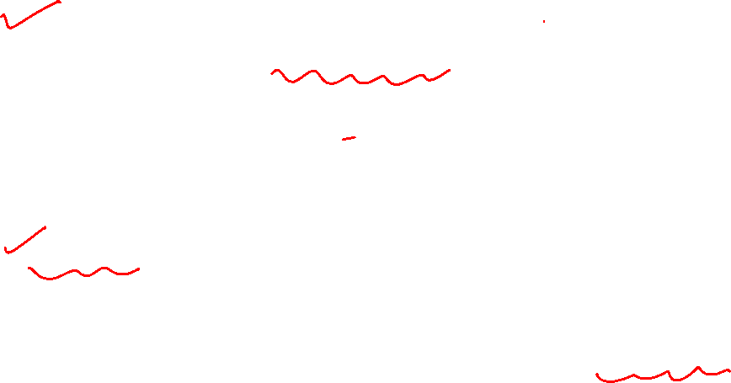

Slide 33
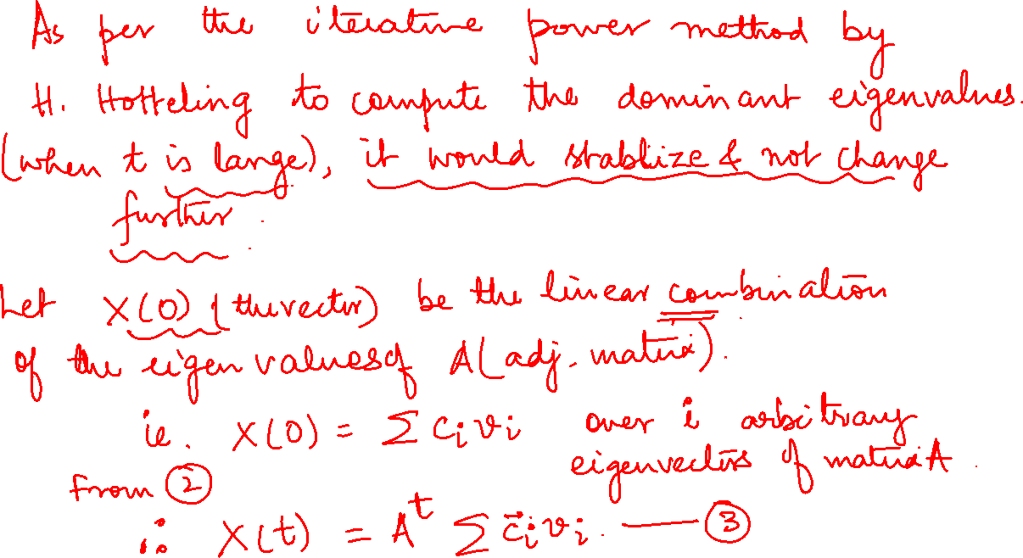
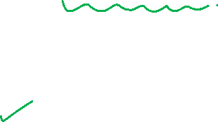

Slide 34
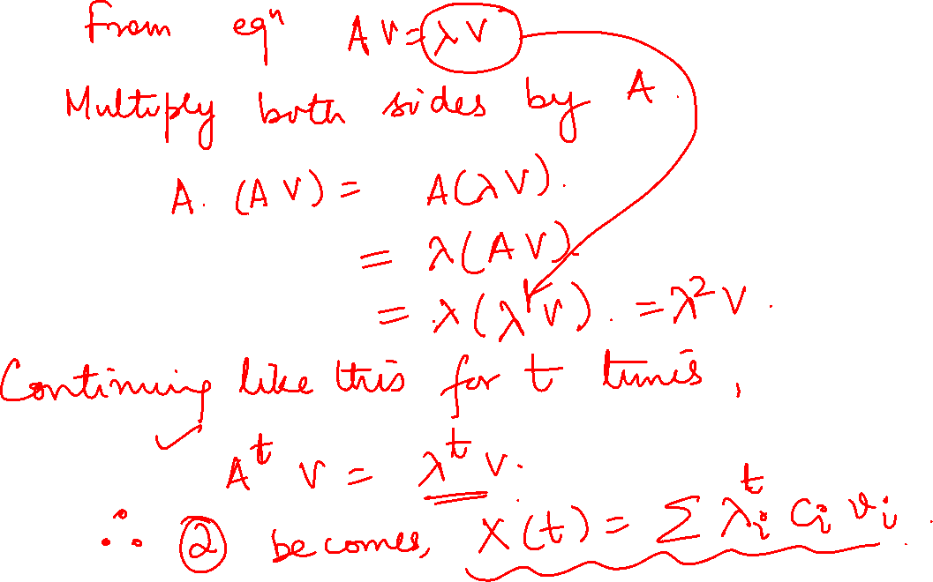


Slide 35
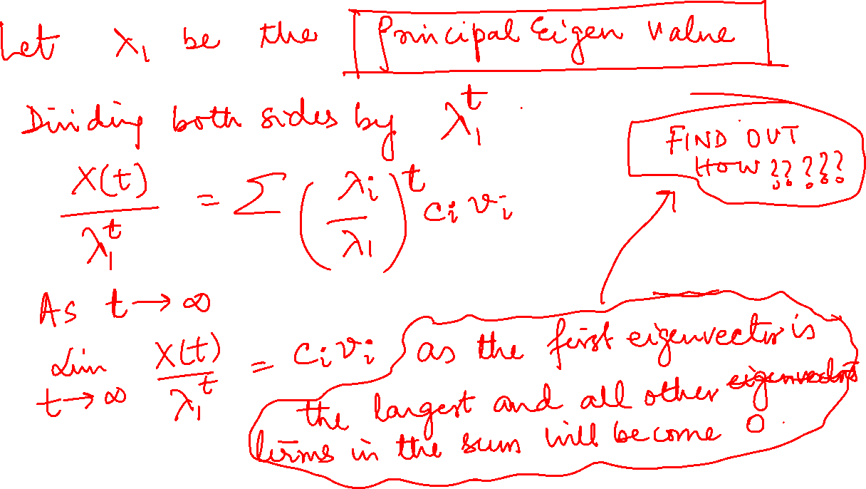
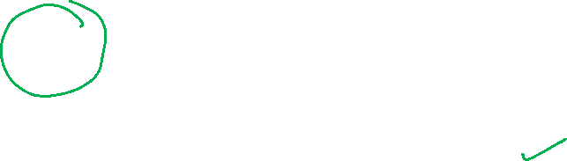

Slide 36
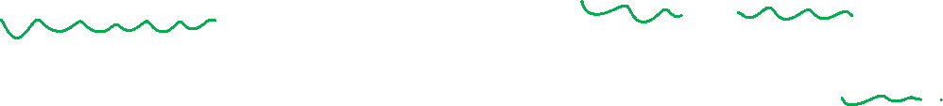
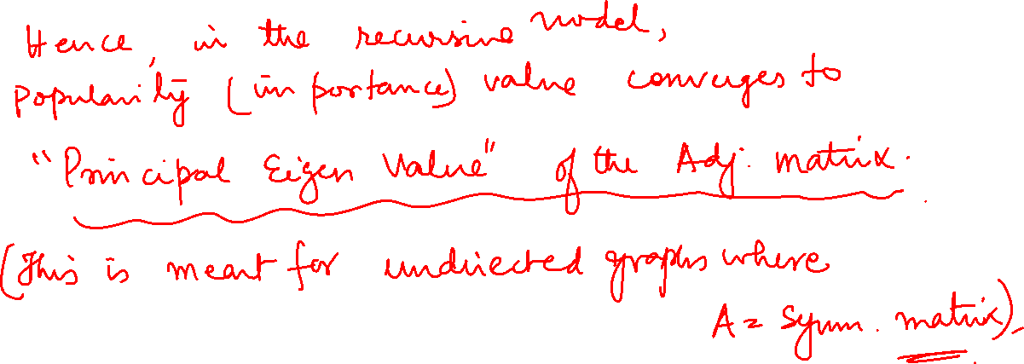
Graph Theory and its Applications UE21CS343AB3
Eigenvector centrality

Slide 37
Graph Theory and its Applications UE21CS343AB3

Slide 38
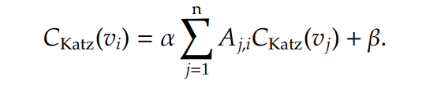
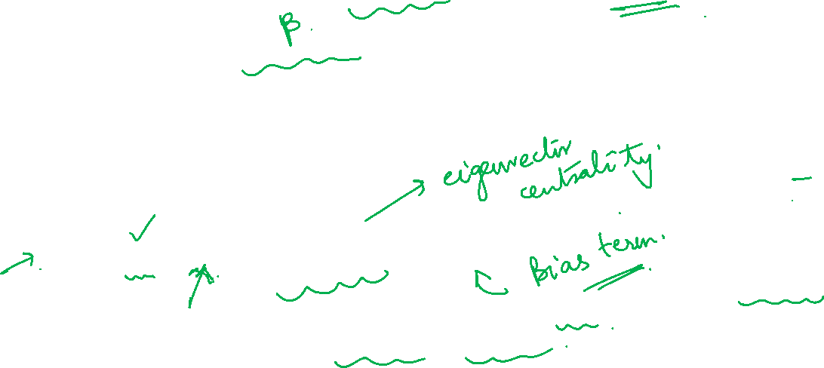
Graph Theory and its Applications UE21CS343AB3
Fixing the Problem of Eigenvector centrality: Katz
Problem is solved by giving atleast some importance to all the nodes.
Thus, by adding a bias term to the centrality value.
The bias term β is added to the centrality values for all nodes (no matter how they are situated in the network).
Katz centrality is formulated as:
Eigenvector centrality modified for directed graphs
The first term is similar to eigenvector centrality, and its effect is controlled by constant α ( takes care of neighbors importance).. The second term β ( takes care of inheriting importance),, is the bias term that avoids zero centrality values

Slide 39
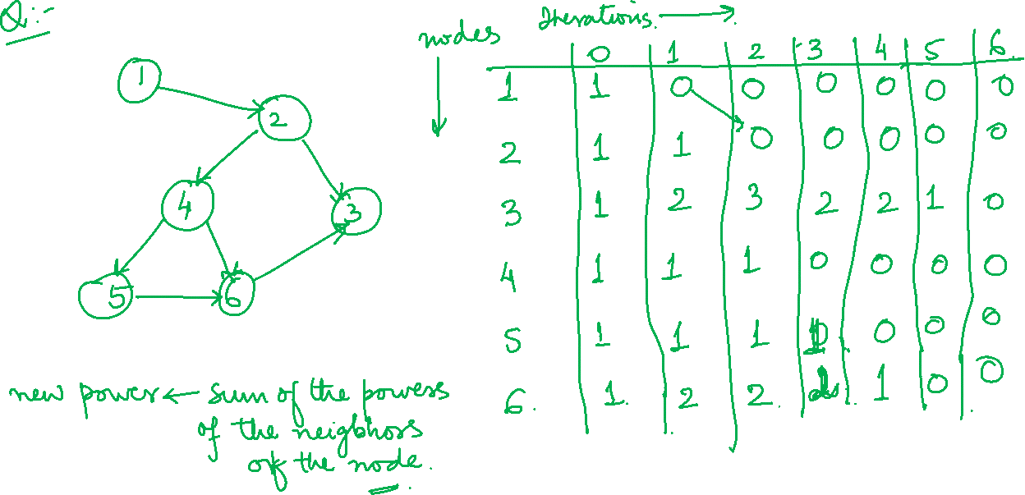
Graph Theory and its Applications UE21CS343AB3

Slide 40

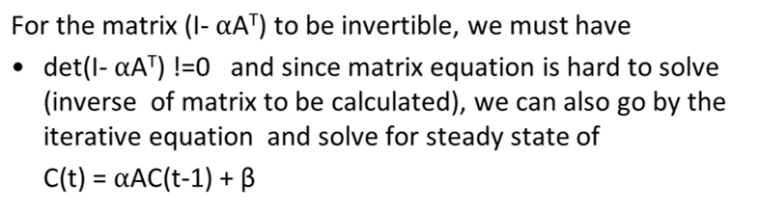

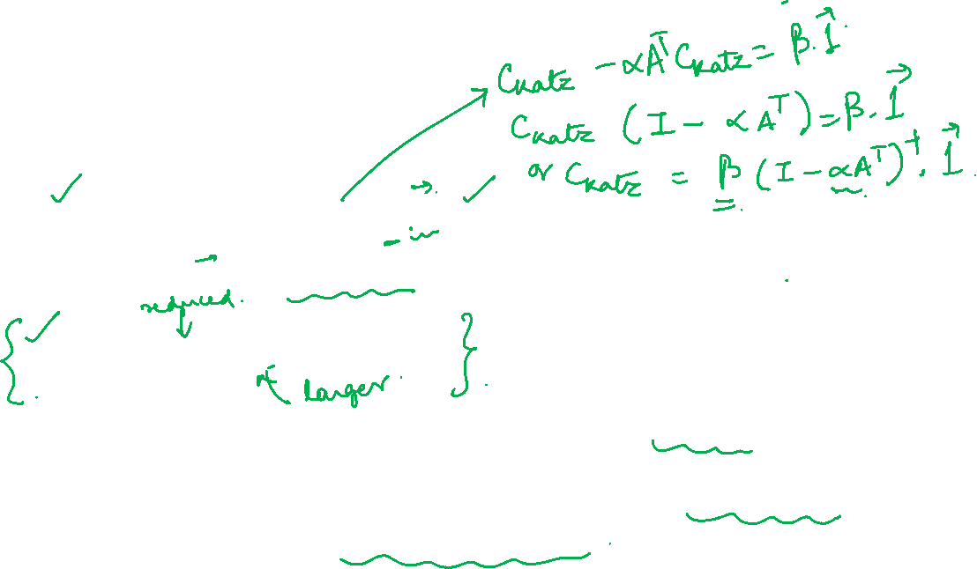
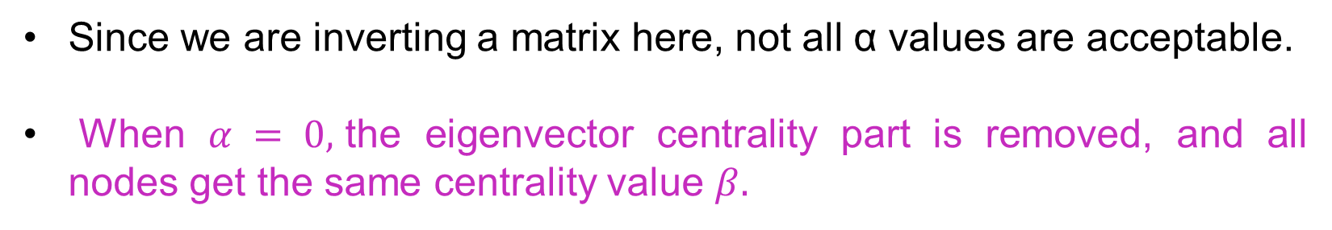
Graph Theory and its Applications UE21CS343AB3
Katz centrality
In vector form, it can be written as:
where 1 is a vector of all 1’s.
Since we are inverting a matrix here, not all α values are acceptable.
When $α = 0,$the eigenvector centrality part is removed, and all nodes get the same centrality value $β.$

Slide 41
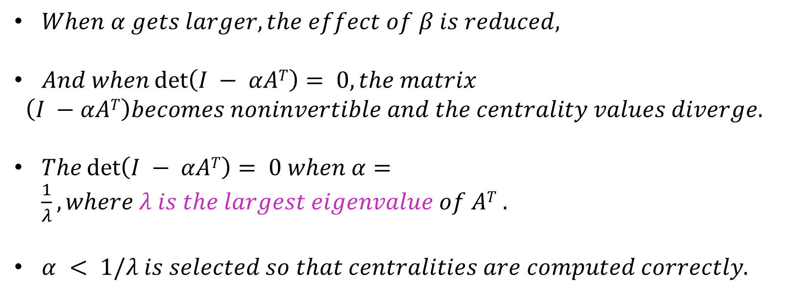
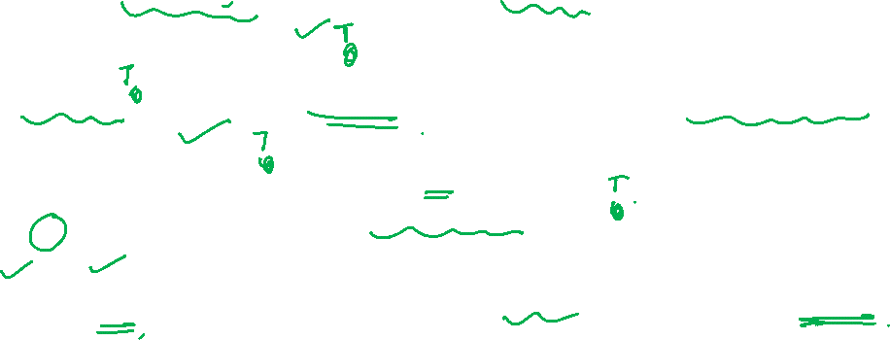
Graph Theory and its Applications UE21CS343AB3
Katz centrality
$When α gets larger, the effect of β is reduced,$
$And when\det\left(I − αAT\right)= 0, the matrix$
$$\left(I −αAT\right)becomes noninvertible and the centrality values diverge.$$
$The\det\left(I − αAT\right)= 0 when α=\frac{1}{λ},where λ is the largest eigenvalue of AT .$
$α < 1/λ is selected so that centralities are computed correctly.$

Slide 42
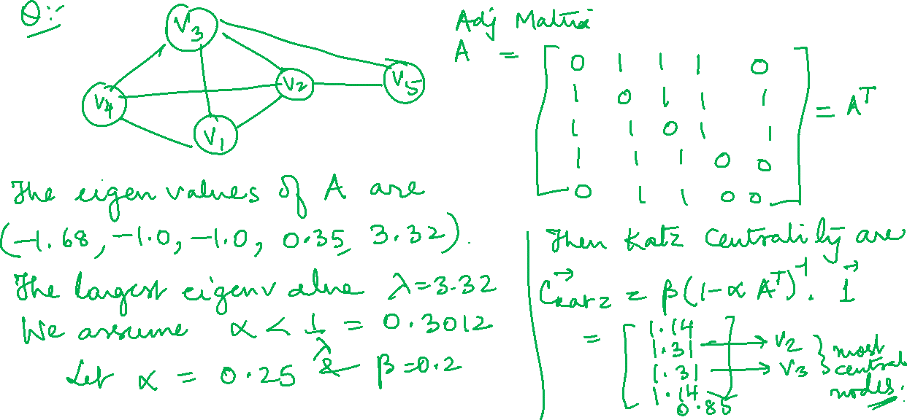
Graph Theory and its Applications UE21CS343AB3

Slide 43
Graph Theory and its Applications UE21CS343AB3

Slide 44
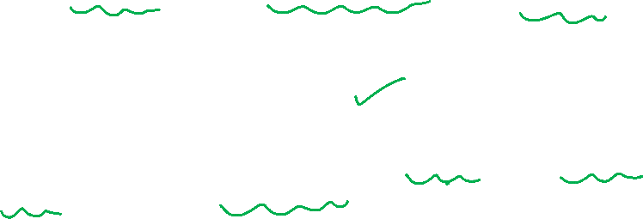
Graph Theory and its Applications UE21CS343AB3
Challenge of Katz centrality
A challenge of Katz centrality in directed graphs is that, once a node becomes an authority (high centrality), it passes all its centrality along all of its out-links.
This means everyone known by a well known person is well known----- NOT NECESSARY AT ALL.
To overcome this problem, a small improvement in Katz is done : Divide the value of passed centrality by the # of outgoing links (outdegree) from that node

Slide 45
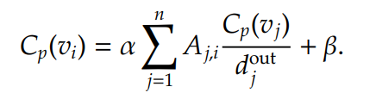


Graph Theory and its Applications UE21CS343AB3
PageRank centrality
$${where d}_{j}^{out}>0$$
This way, each connected neighbor gets a fraction of the source node’s centrality and not all centrality is passed on.
The above equation can be expressed in matrix format:

Slide 46

Graph Theory and its Applications UE21CS343AB3
Pagerank centrality
Similar to Katz centrality, in practice, α < 1/λ is selected, where λ is the largest eigenvalue of A^{T}D⁻¹ . In undirected graphs, the largest eigenvalue of A^{T}D⁻¹ is λ = 1; therefore, α < 1.
PR centrality is used by Google Search Engine for ordering web pages.
Web pages and their links are represented by huge web graphs.
PageRank centrality is the correction introduced to Katz Centrality.
Both Katz and PageRank Centrality are variants of Eigen Vector Centrality !!

Slide 47
Graph Theory and its Applications UE21CS343AB3
Eigen Vector Centrality Modified for Directed Graph
Popularity for undirected graph can be recast for popularity in a directed graph
In a directed graph (such as web), popularity is passed on only by incoming edges. Hence, popularity becomes zero even though the node can have many outgoing edge connected to it if it does not have an incoming edge
In diagram, A has popularity = 0 and since B has one incoming edge from A, B also has popularity or centrality 0 !! This may propagate through the network !
To resolve this problem we add initial popularity β to the centrality values for all nodes whereas alpha depends on the neighborhood
X_{i}(1) = α∑A_{ji} X_{j}(0) + β
B
A
C
D

Slide 48

vector of all 1’s
Rewriting equation in a vector form with C as the centrality
Katz centrality:

Slide 49
PageRank Fix to Katz Centrality For Directed Graph
Graph Theory and its Applications UE21CS343AB3
Issue : Everyone known by a well-known person is assumed to be well-known
To mitigate this problem we can divide the value of passed centrality by the number of outgoing links
PageRank centrality is the correction introduced to Katz Centrality.
Both Katz and PageRank Centrality are variants of Eigen Vector Centrality !!

Slide 50
Graph Theory and its Applications UE21CS343AB3
Pagerank centrality

Slide 51




Graph Theory and its Applications UE21CS343AB3
Example of Pagerank centrality
Then the PR values are given by:

Slide 52
THANK YOU
Dr. Arti Arya
Department of Computer Science and Engineering
artiarya@pes.edu

